Slide 1
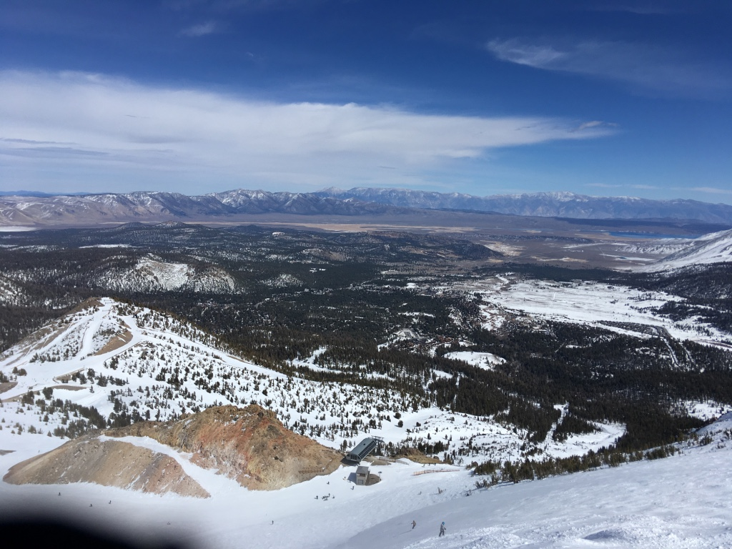
Volcanism, Structure, and Geochronology of Long Valley Caldera, Mono County, California
Bailey et al., 1976
Presented by Luke J. Schranz

Slide 3
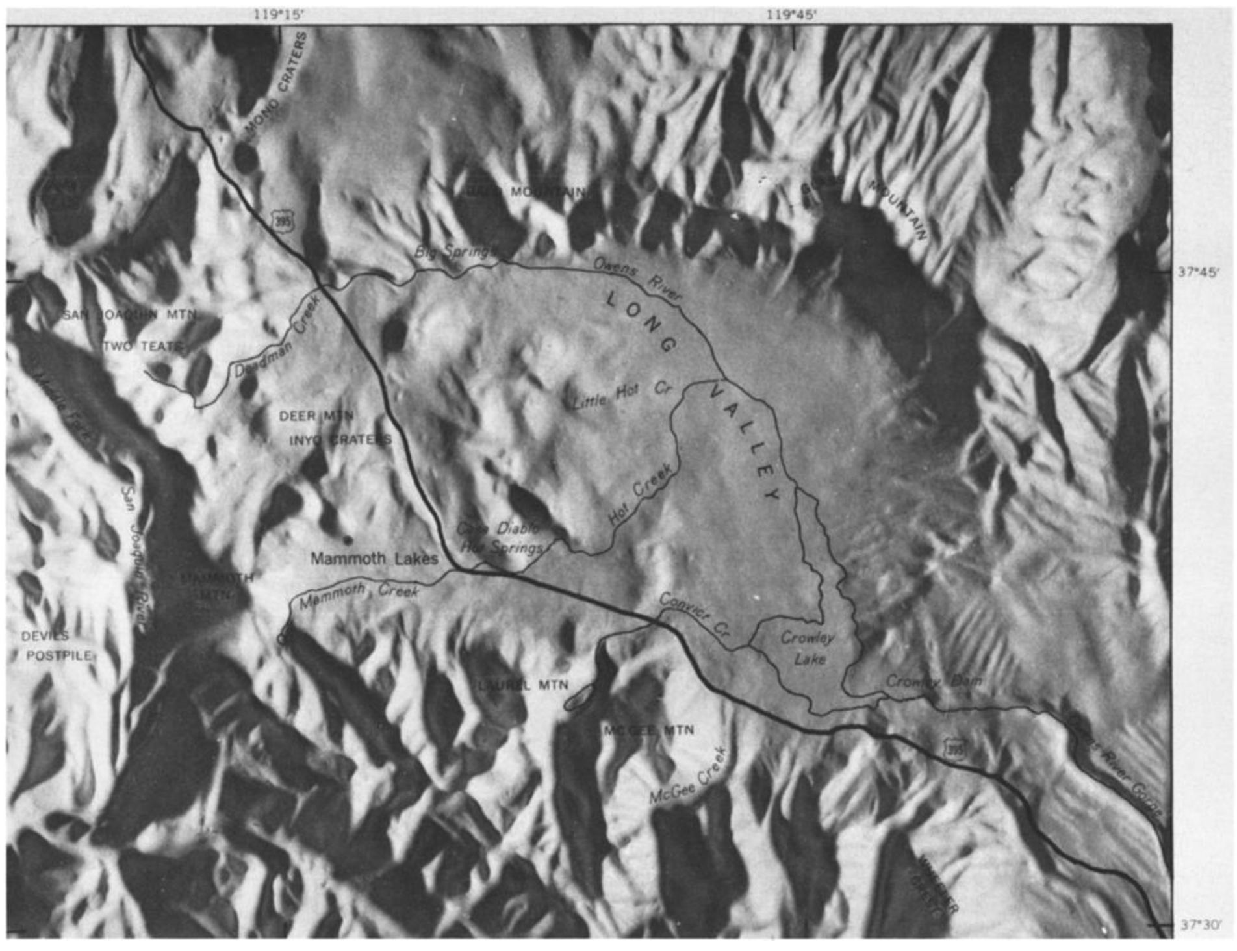

Slide 4
USGS

Slide 5
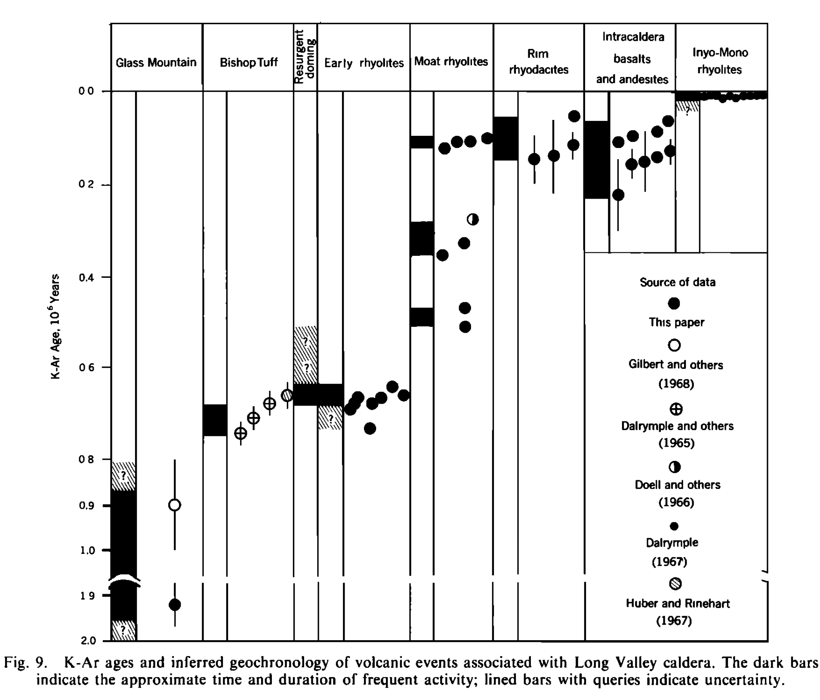

Slide 6
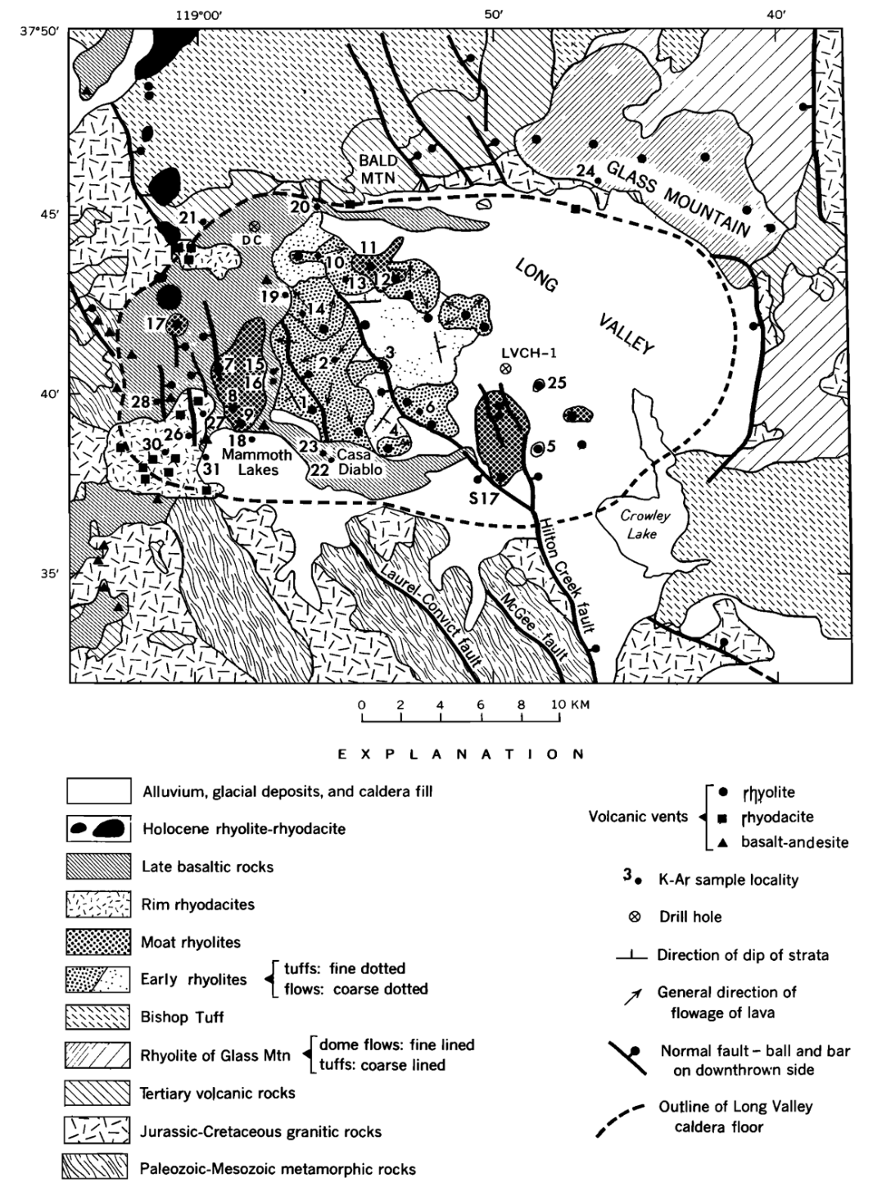
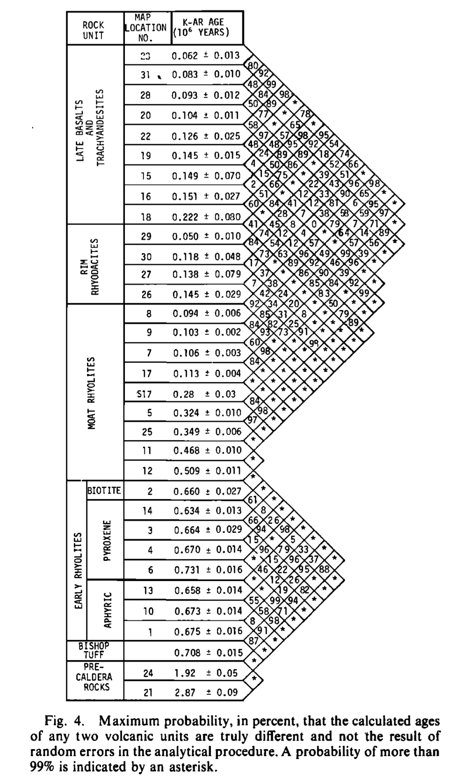

Slide 7
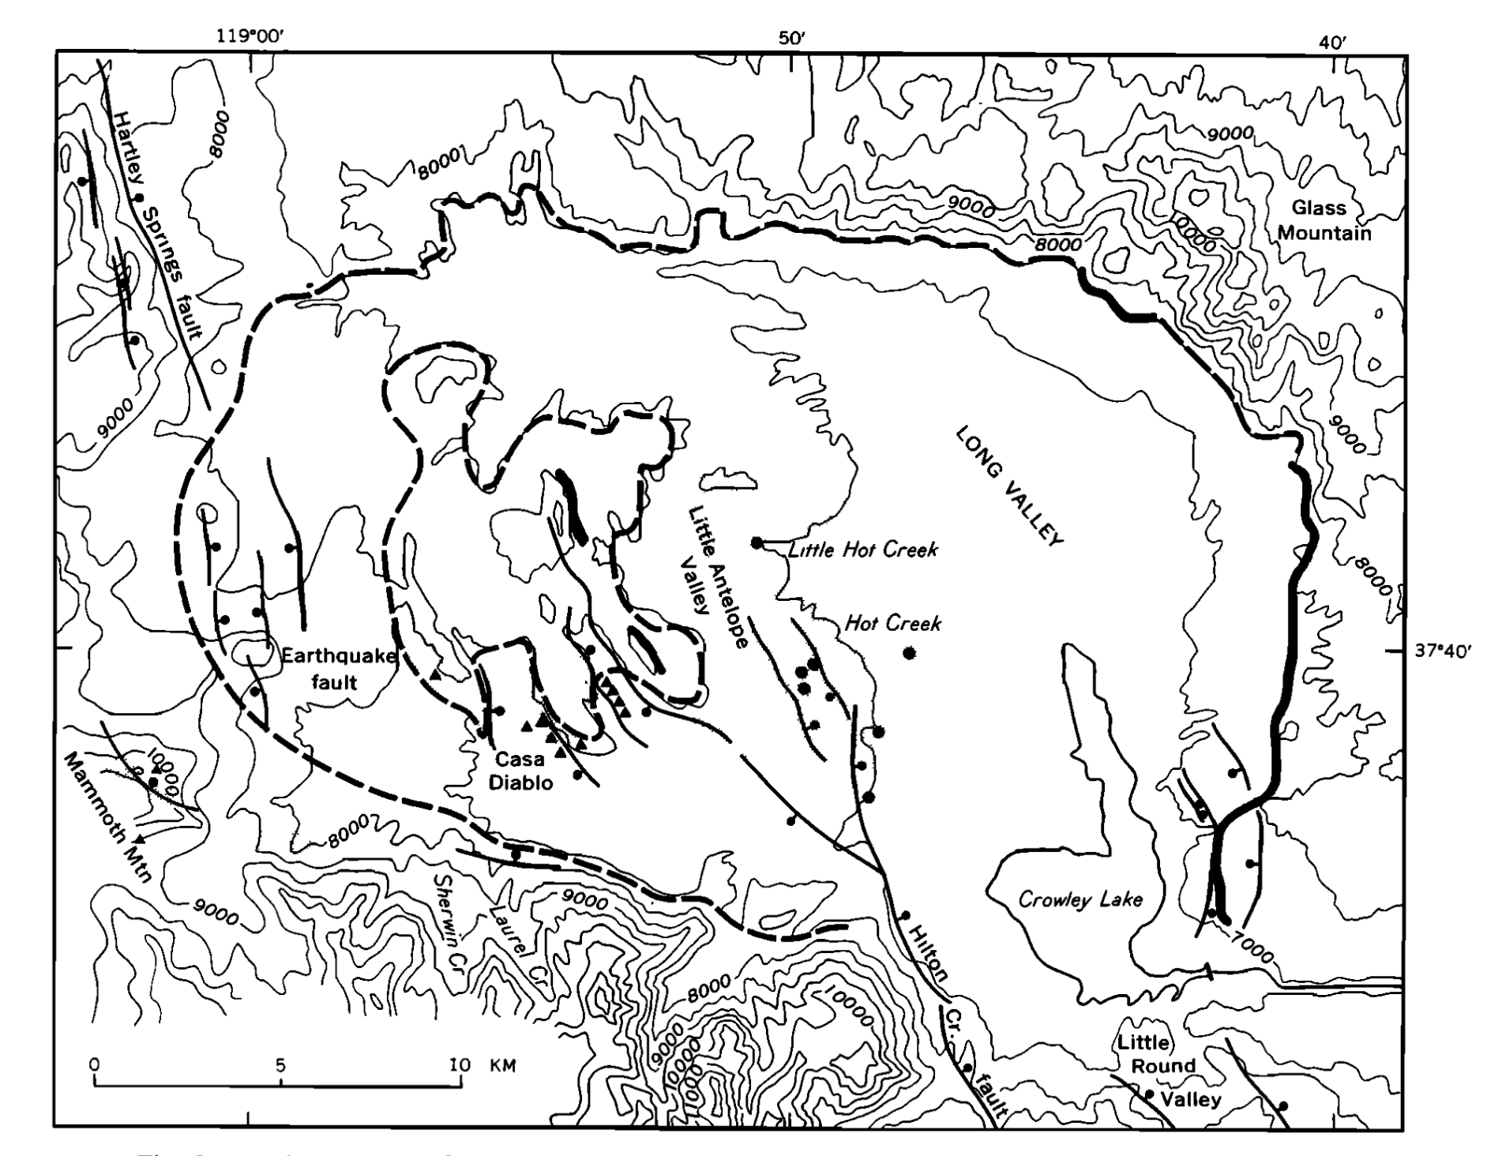

Slide 8
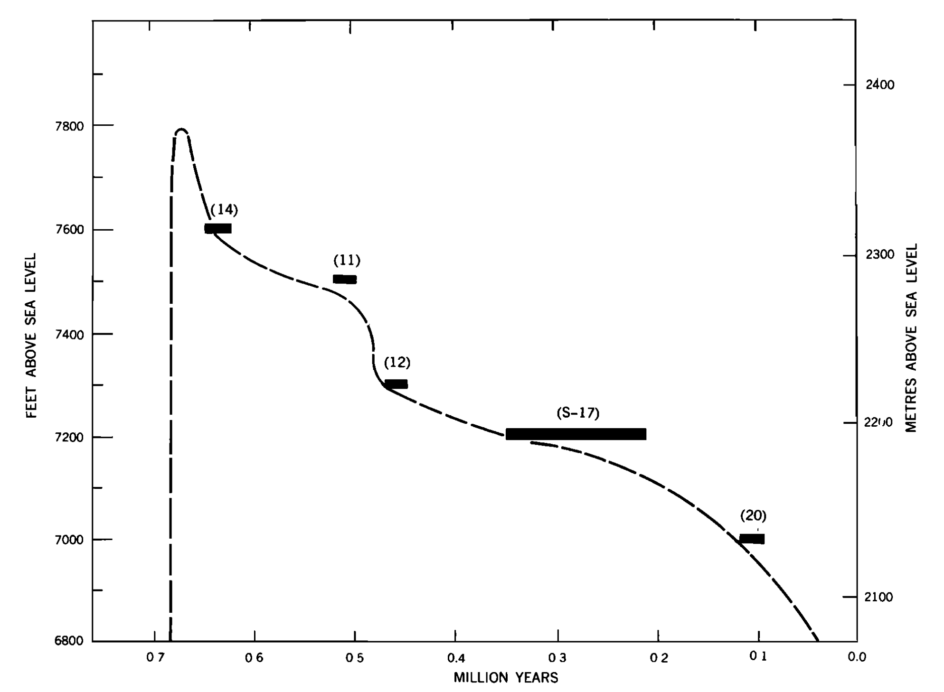

Slide 9
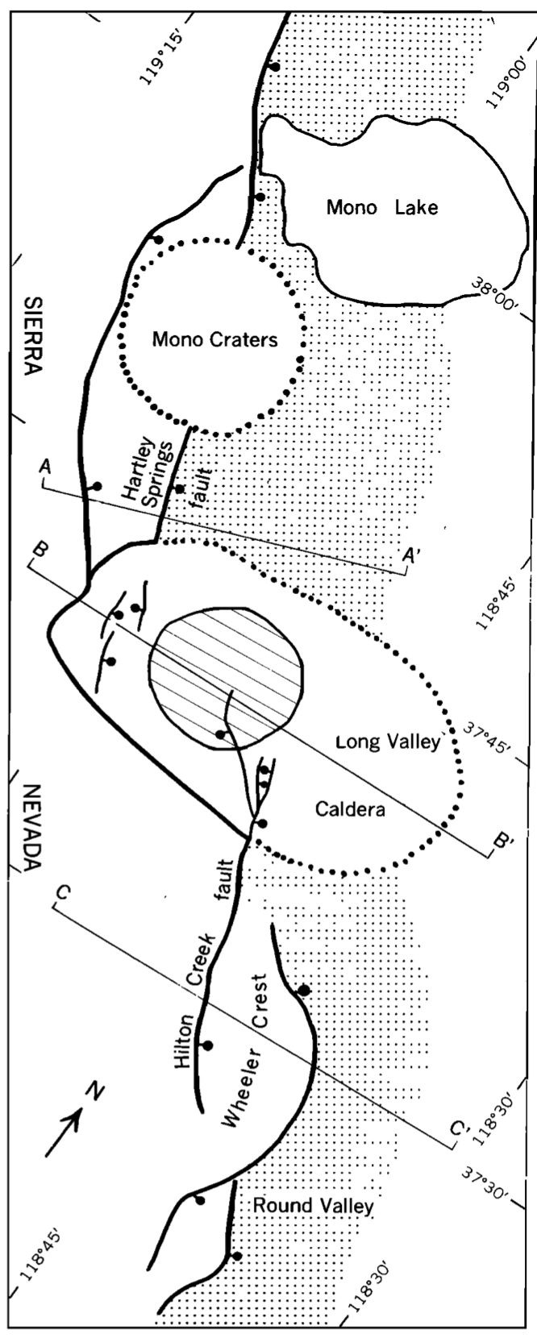
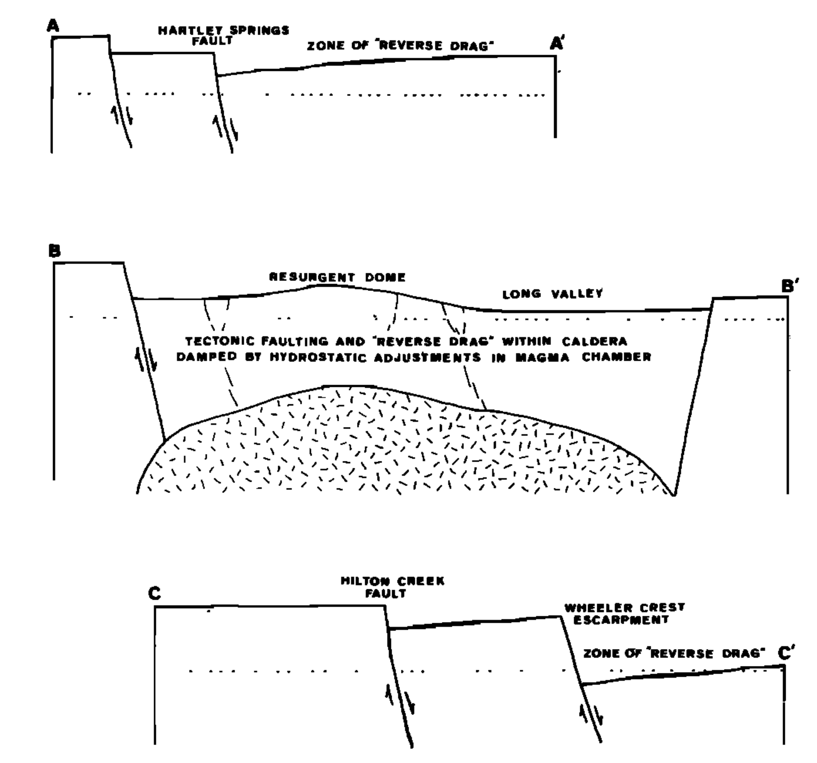

Slide 10
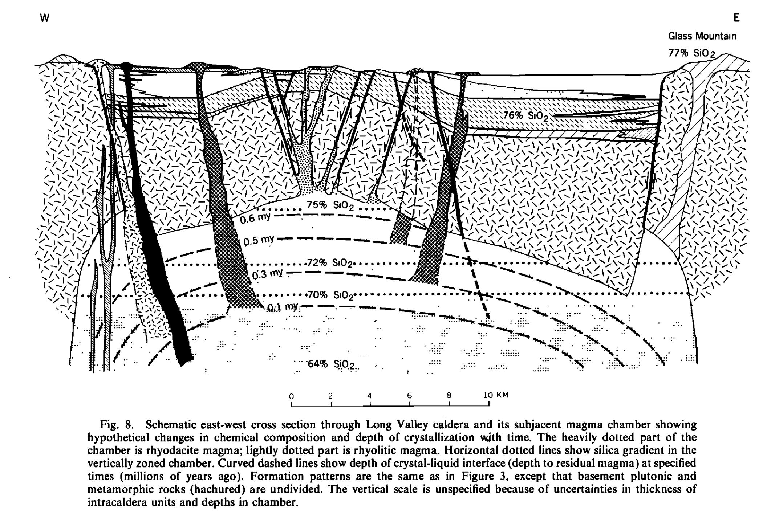

Slide 12
Conclusions and Questions
Long Valley caldera erupted 0.7 Ma
Magmatic development from 1.9-0.6 Ma
Magma is not likely fully crystallized and high geothermal resource potential

